Slide 1

CS 5/6110, Software Correctness Analysis, Spring 2022
Ganesh Gopalakrishnan
School of Computing
University of Utah
Salt Lake City, UT 84112

Slide 2
Lecture 14 : First-Order Logic aka predicate logic
Read from Bradley and Manna, Chapter 2
Practice using the files checked into this directory
Having good implementations of SAT-checking for decidable fragments of FOL is why formal methods and rigorous software testing have suddenly become practical!
Alloy introduces a relational logic
FOL expression allowed, maybe even HOL
But all “proofs” are finite-model proofs
Moral: Know relations, functions, FOL, proofs
To do well in software testing, specification, and correctness verification
“Noble bugs” a direct consequence of computability theory
“Stupid bugs” arise due to the Towers of the Babel

Slide 3
An example of FOL (“classical”)
Some patients like every doctor
No patient likes a quack
Prove that no doctor is a quack

Slide 4
An example of FOL (“classical”)
Let “P” be people containing x,y,z, …
Let “p” be a patient-predicate – e.g. p(x)
Let “d” be a doctor-predicate – e.g. d(y)
Let “q” be a quack-predicate – e.g. q(z)
Let “l” be the likes-predicate – e.g. l(x,y) [T/F], !l(x,z) [T/F] etc..
Let’s now see how to model this problem
Forall = “all” and ThereExists = ”exists”
In Alloy it is all / some

Slide 5
An example of FOL (“classical”)
Reminder: P, p, d, q, l are the symbols we have so far
All quantification is over “P” or people
Some patients like every doctor
exists x : p(x) and [all y : d(y) -> l(x,y)]
No patient likes a quack
… give it a shot …
Prove that no doctor is a quack
… state the proof-goal in FOL – give it a shot …

Slide 6
An example of FOL (“classical”)
Reminder: P, p, d, q, l are the symbols we have so far
All quantification is over “P” or people
Some patients like every doctor
exists x : p(x) and [all y : d(y) -> l(x,y)]
No patient likes a quack
all x,y : [ p(x) & q(y) => ! l(x,y) ]
Prove that no doctor is a quack
Goal : prove that all x : d(x) => !q(x)

Slide 7
An example of FOL (“classical”)
Reminder: P, p, d, q, l are the symbols we have so far
All quantification is over “P” or people
Some patients like every doctor
exists x : p(x) and [all y : d(y) -> l(x,y)]
question: Where else can we put “all y” ?
No patient likes a quack
all x,y : [ p(x) & q(y) => ! l(x,y) ]
Prove that no doctor is a quack
Goal : prove that all x : d(x) => !q(x)

Slide 8
An example of FOL (“classical”)
Reminder: P, p, d, q, l are the symbols we have so far
All quantification is over “P” or people
Some patients like every doctor
exists x : p(x) and [all y : d(y) -> l(x,y)]
question: Where else can we put “all y” ?
Which of these “makes sense”
exists x : all y: [ p(x) and [d(y) -> l(x,y) ] ]
All y : exists x : [ p(x) and [d(y) -> l(x,y) ] ]
No patient likes a quack
all x,y : [ p(x) & q(y) => ! l(x,y) ]
Prove that no doctor is a quack
Goal : prove that all x : d(x) => !q(x)

Slide 9
Example of FOL (“classical”): Proof by contra
A1: exists x : p(x) and [all y : d(y) -> l(x,y)]
A2: all x,y : [ p(x) & q(y) => ! l(x,y) ]
G: all x : d(x) => !q(x)
NG: …give it a shot…
A1 skolemize x with p0
A1sk: p(p0) and [all y : d(y) -> l(p0,y)]

Slide 10
Example of FOL (“classical”): Proof by contra
A1: exists x : p(x) and [all y : d(y) -> l(x,y)]
A2: all x,y : [ p(x) & q(y) => ! l(x,y) ]
G: all x : d(x) => !q(x)
NG: exists x : d(x) & q(x)
A1 skolemize x with p0
A1sk: p(p0) and [all y : d(y) -> l(p0,y)]
NGsk: Skolemize NG : d(d0) & q(d0)

Slide 11
Example of FOL (“classical”): Proof by contra
A1: exists x : p(x) and [all y : d(y) -> l(x,y)]
A2: all x,y : [ p(x) & q(y) => ! l(x,y) ]
G: all x : d(x) => !q(x)
NG: exists x : d(x) & q(x)
A1sk: p(p0) and [all y : d(y) -> l(p0,y)]
NGsk: d(d0) & q(d0)
A1sk with d0 specialization: p(p0) & d(d0) => l(p0,d0)
Now what?
Hint : we have not used A2

Slide 12
Example of FOL (“classical”): Proof by contra
A1: exists x : p(x) and [all y : d(y) -> l(x,y)]
A2: all x,y : [ p(x) & q(y) => ! l(x,y) ]
G: all x : d(x) => !q(x)
NG: exists x : d(x) & q(x)
A1sk: p(p0) and [all y : d(y) -> l(p0,y)]
NGsk: d(d0) & q(d0)
A1sk with d0 specialization: p(p0) & d(d0) => l(p0,d0)
Now what?
Hint : we have not used A2
A2sp with p0 and d0: p(p0) & q(d0) => !l(p0,d0)
Do you smell the contradiction?
How to finish?

Slide 13
Example of FOL (“classical”): Proof by contra
A1: exists x : p(x) and [all y : d(y) -> l(x,y)]
A2: all x,y : [ p(x) & q(y) => ! l(x,y) ]
G: all x : d(x) => !q(x)
NG: exists x : d(x) & q(x)
A1sk: p(p0) and [all y : d(y) -> l(p0,y)]
NGsk: d(d0) & q(d0)
A1sk with d0 specialization: (A1sk’): p(p0) & [ d(d0) => l(p0,d0) ]
Now what?
A2sp with p0 and d0: p(p0) & q(d0) => !l(p0,d0)
MP of A1sk’ and NGsk : l(p0,d0)
Contra of !l(p0,d0) and l(p0,d0)

Slide 14
Lecture 14 : First-Order Logic aka predicate logic : Basics
There exist consistent axiomatizations of FOL
There exist complete axiomatizations of FOL
FOL is only semi-decidable
Only procedures exist for deciding validity
No algorithms
No TMs that don’t loop
Semi-algorithms exist because of completeness
If indeed valid (true), there is a proof
And we can discover the proof
via systematic enumeration of all legal inference sequences

Slide 15
Encoding the “doctor/quack theorem” in Alloy
What all FOL concepts are involved?
How to encode each of them in Alloy?

Slide 16
Encoding the “doctor/quack theorem” in Alloy
What all FOL concepts are involved?
Propositional variables
Zero-ary predicates
Predicates of higher arity
One-ary predicates (or subsets of the universe in most cases)
Two-ary predicates (pairs over U)
Zero-ary functions
Or constants in various value domains
One-ary and higher-arity functions
How to encode each of them in Alloy?
We will study how the encoding goes for the doctor/quack theorem
Then we will study how to encode general FOL concepts using Alloy
Again, for bounded-model proofs
Look at Alloy-Constructs-and-Usage.txt for a quick overview

Slide 17
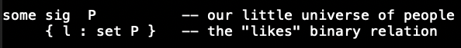
Alloy doctors/quacks encoding

Slide 18
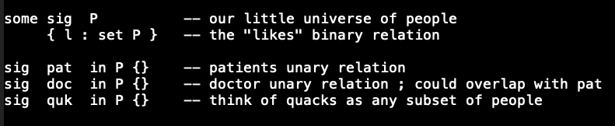
Alloy doctors/quacks encoding

Slide 19
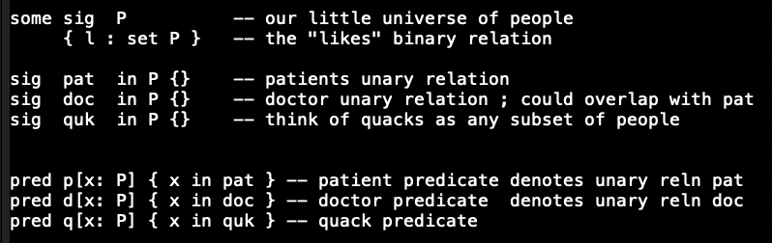
Alloy doctors/quacks encoding

Slide 20
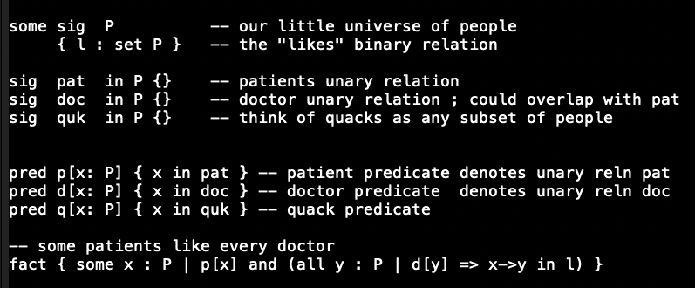
Alloy doctors/quacks encoding

Slide 21
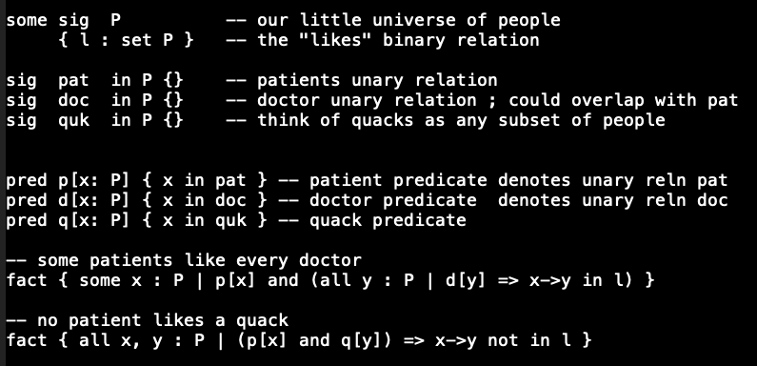
Alloy doctors/quacks encoding

Slide 22
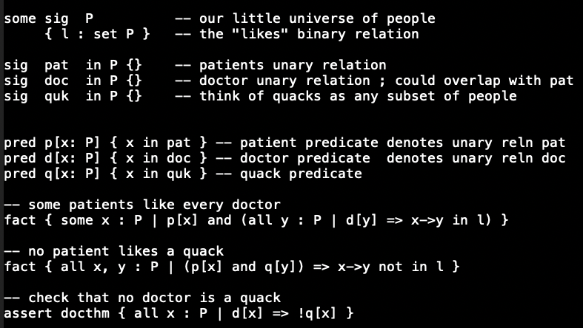
Alloy doctors/quacks encoding

Slide 23
Alloy checks asserts for validity by negating them and checking whether they are sat or not If Sat then … ? If Unsat then … ? Remember that any Boolean formula is * Valid * A contradiction (its negation is valid) * Neither – it and its negation are satisfiable

Slide 24
Alloy checks asserts for validity by negating them and checking whether they are sat or not If Sat then the original assertion is invalid If Unsat then the original assertion is valid Just to be thorough, we will (later) do this: * Write an assertion Assn * Write negAssn = !Assn * We will check both * If Assn’s “check” says “no counterexample, “Assn may be valid”, then ensure that !Assn is satisfiable (there is a counterexample for it) BUT if both Assn and !Assn generate counterexamples, then they are merely satisfiable but not valid AND also not contradictions !!

Slide 25
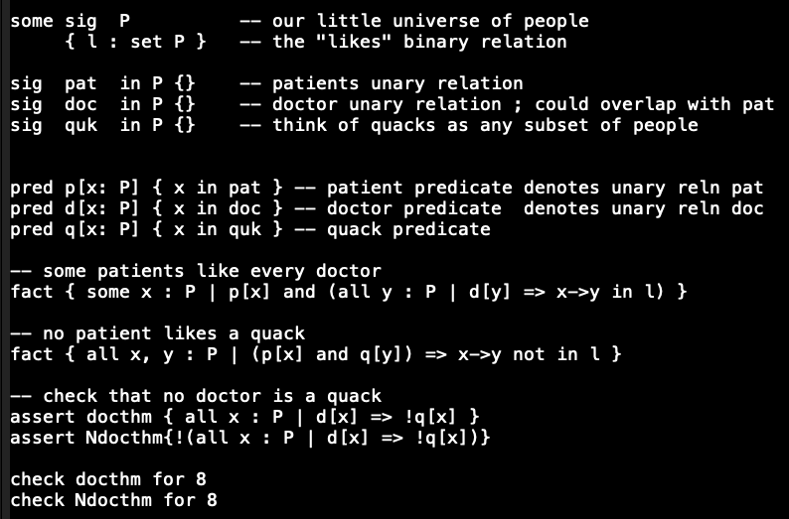
Alloy doctors/quacks encoding

Slide 26
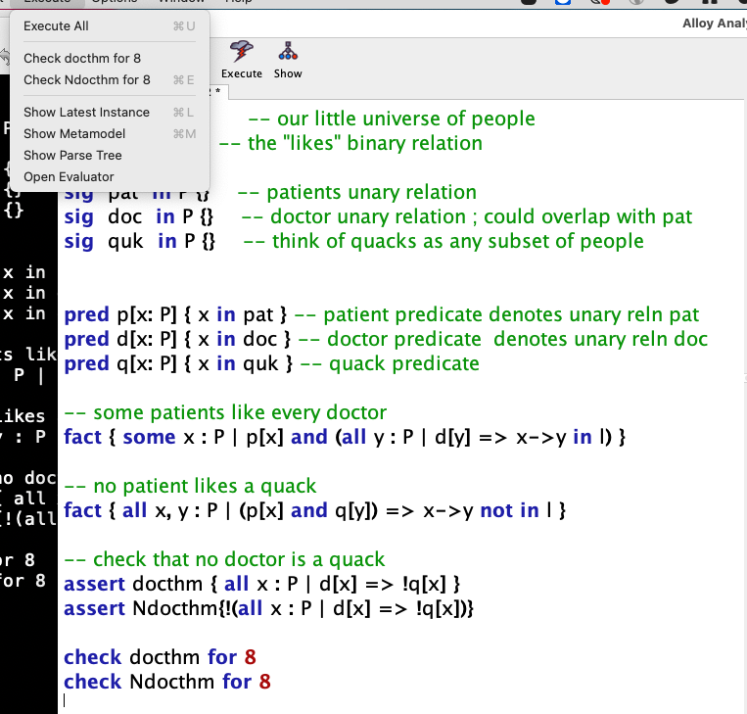
Alloy doctors/quacks encoding
Observe that
Via tbe pulldown
You can run any of the asserts
You’ve planted !!

Slide 27
Excerpts from Bradley and Manna

Slide 28
Excerpts from Bradley and Manna

Slide 29
Excerpts from Bradley and Manna

Slide 30
Excerpts from Bradley and Manna

Slide 31
Excerpts from Bradley and Manna

Slide 32
Excerpts from Bradley and Manna

Slide 33
Excerpts from Bradley and Manna

Slide 34
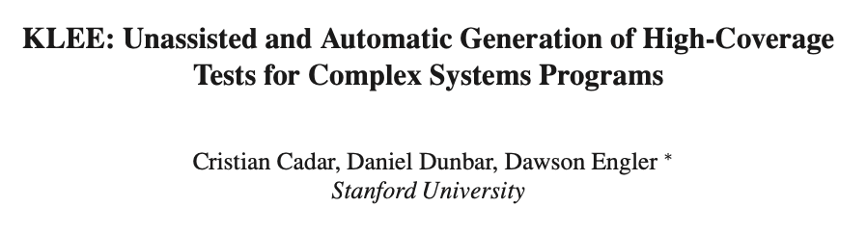

Slide 35
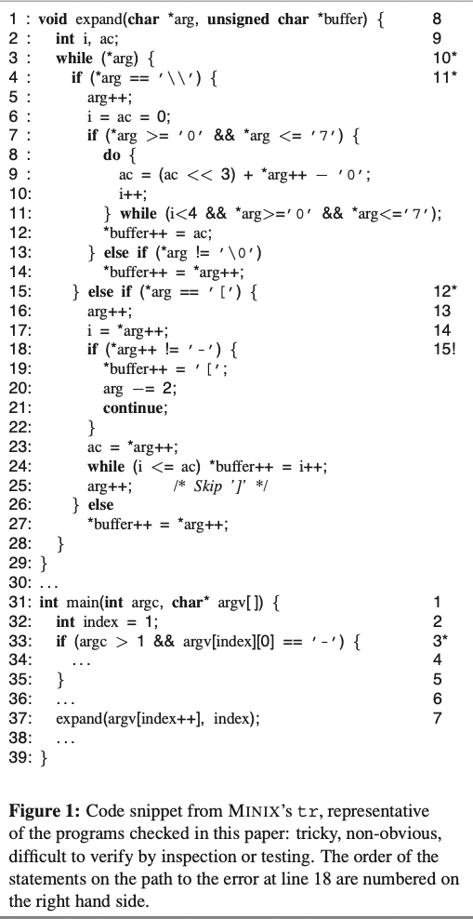
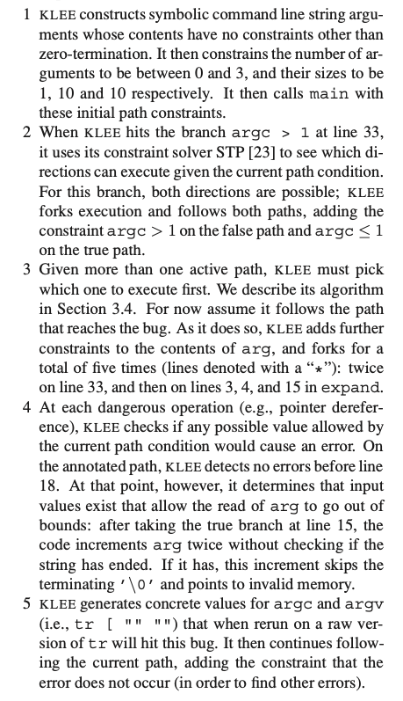
KLEE
OSDI
2008

Slide 36
Why can’t we crank through all inputs/states?
Your answer here for a C program that has exactly one 32-bit register
How about a 64-bit register?
Your answer here for a C program with 1k bytes of state and 64 bits of input
How about a C program with 5 threads with 5 sequential steps? How many interleavings?
How about something larger?

Slide 37
The main technology!
Progress in Boolean Satisfiability is central to the magic I’m going to demo
SAT-solving increased by 1000x or more (in performance)
SAT alone is not sufficient
SMT-solving was essential
Think of the SEND + MORE = MONEY problem!
Progress in SMT-solving happened this way
Nelson/Oppen methods of the 1980’s and Shostak’s method
SVC and CVC and Yices
Then Z3, and now CVC4 and a whole array of others!
Rides on the power of SAT-solving but their “theory-solving” is key
KLEE uses “STP”, an SMT solver that can handle bit-arrays and uninterpreted functions well
This is why we must study mathematical logic
took 1000s of years since Euclid, 170 years since Boole, 100 years since Shannon, and 120 years since Russell, Peano and others to get here!
in addition to all those other “cool topics” to which students are flocking these days!
(What are some of those?!)

Slide 38
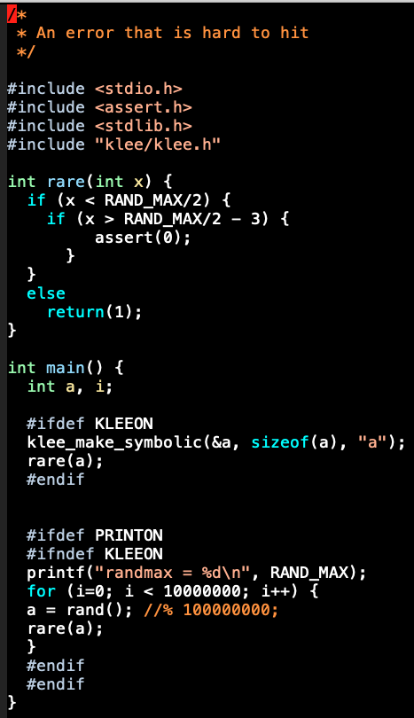
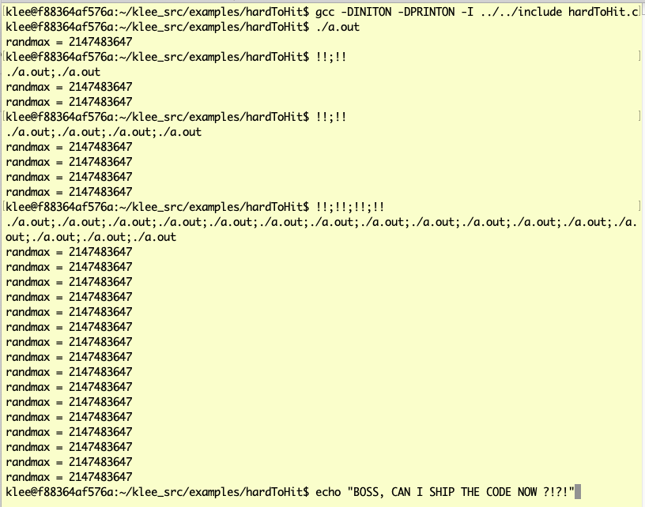
Demo-1 : a hard-to-test program under conventional testing and then KLEE

Slide 39
Demo-1 : a hard-to-test program under conventional testing and then KLEE
Would you put your child / father / sister …
in an airplane that contains this code,
hoping the assert is never hit?
If not, what would you, as a responsible engineer,
do today??

Slide 40
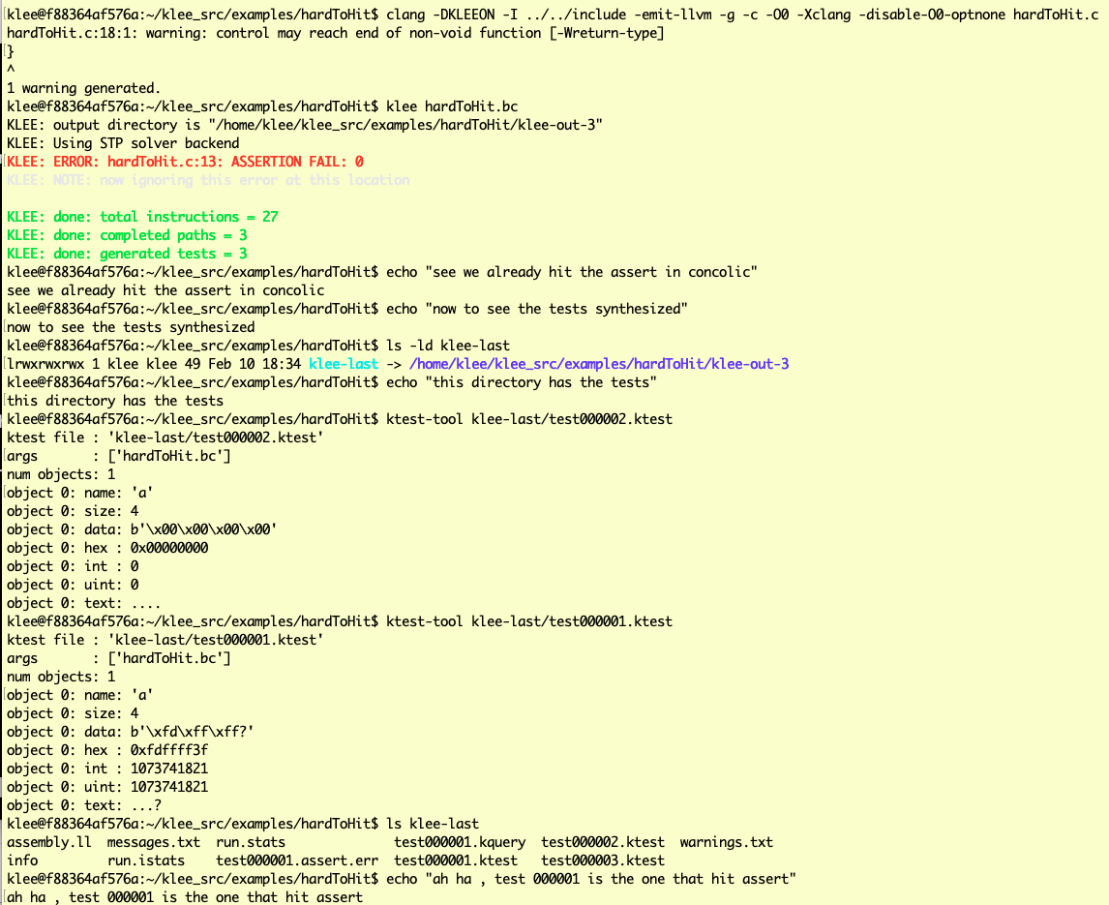
Enter KLEE !!

Slide 41
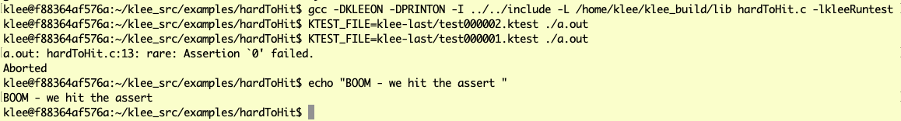
Enter KLEE !!

Slide 42
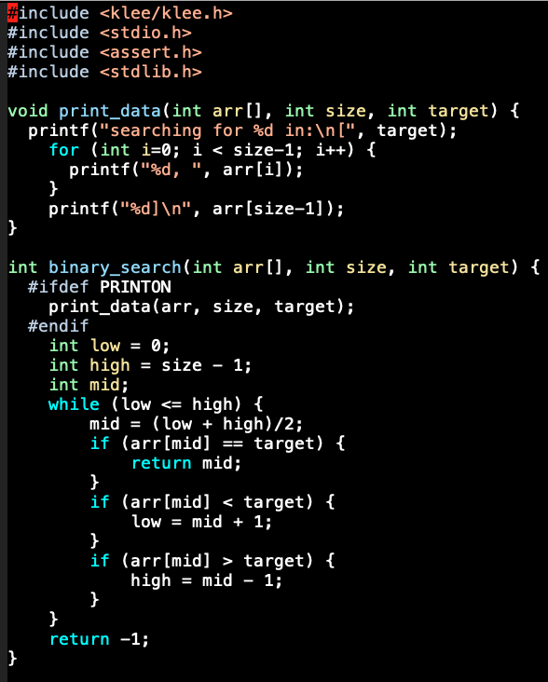
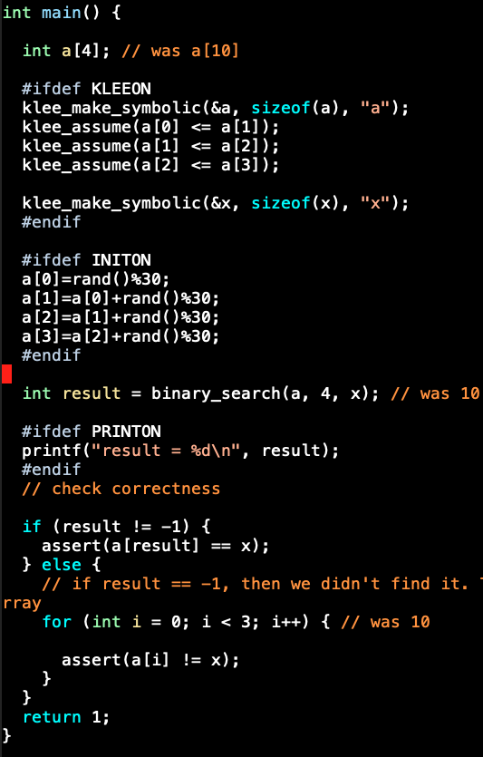
Demo-2 Binary Search Looks OK? Ship it?!

Slide 43
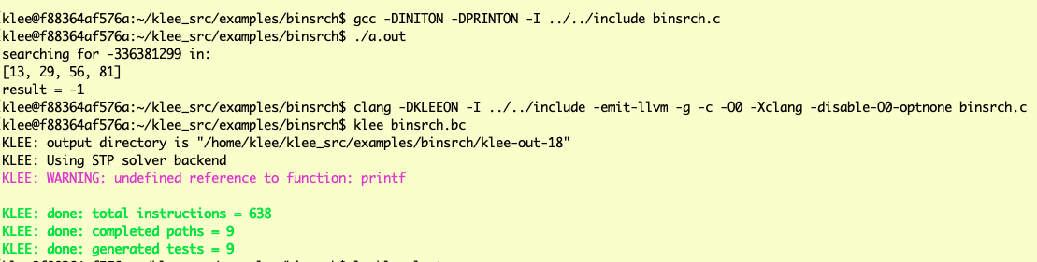
Demo-2 Binary Search Looks OK? Ship it?!

Slide 44
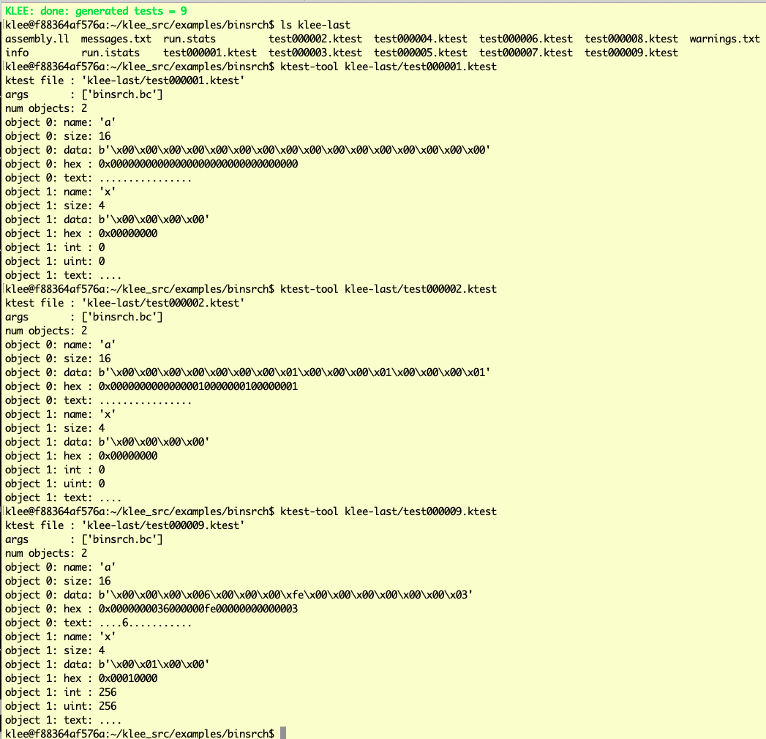
Demo-2 Binary Search Looks OK? Ship it?!

Slide 45
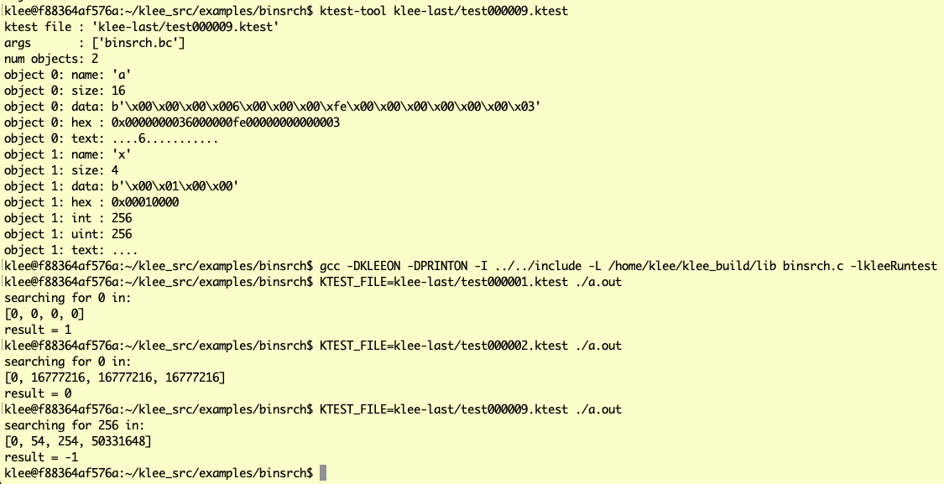
Demo-2 Binary Search Looks OK. Closer to shipping. What was achieved? * tests that cover every path * default C-level checks such as array out of bounds, null de reference i.e. FEWER BUGS

Slide 46
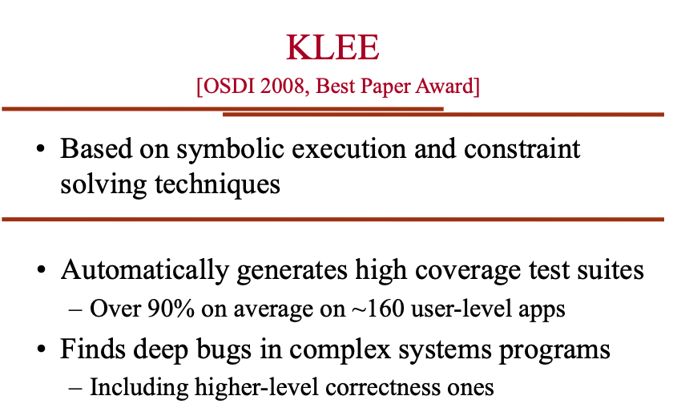
What does KLEE do? (Cadar’s slides)

Slide 47
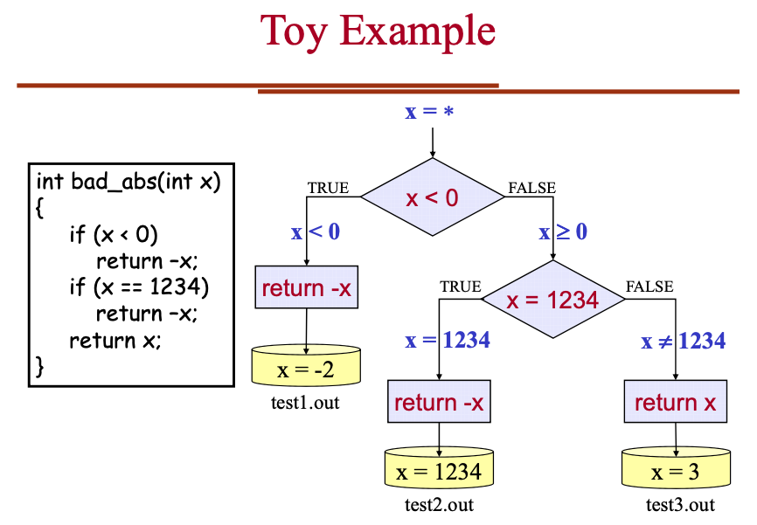
How does KLEE work? (Cadar’s slides)

Slide 48
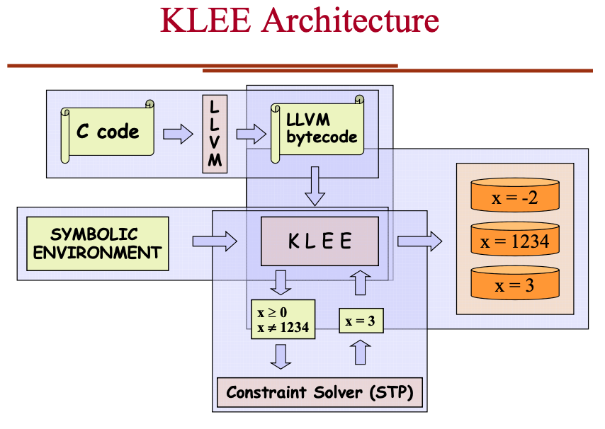
How does KLEE work? (Cadar’s slides)

Slide 49
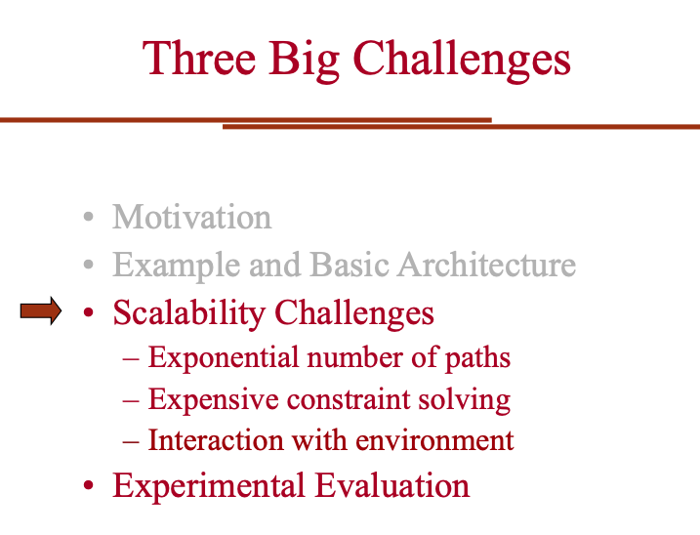
Engineering KLEE to be efficient (Cadar)

Slide 50
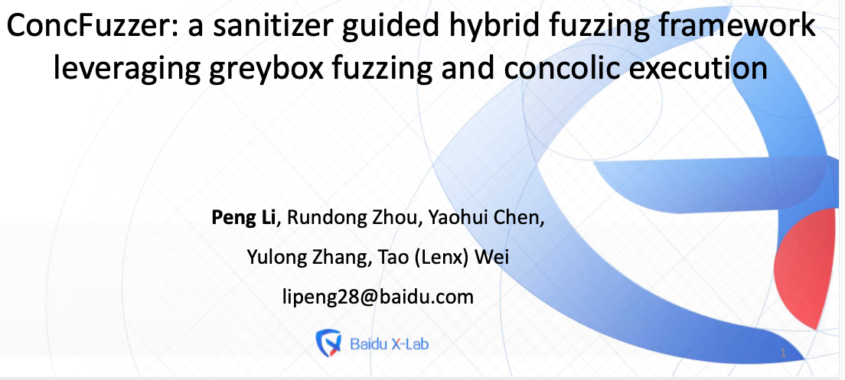
How good is KLEE (Dr. Peng Li’s slides)

Slide 51
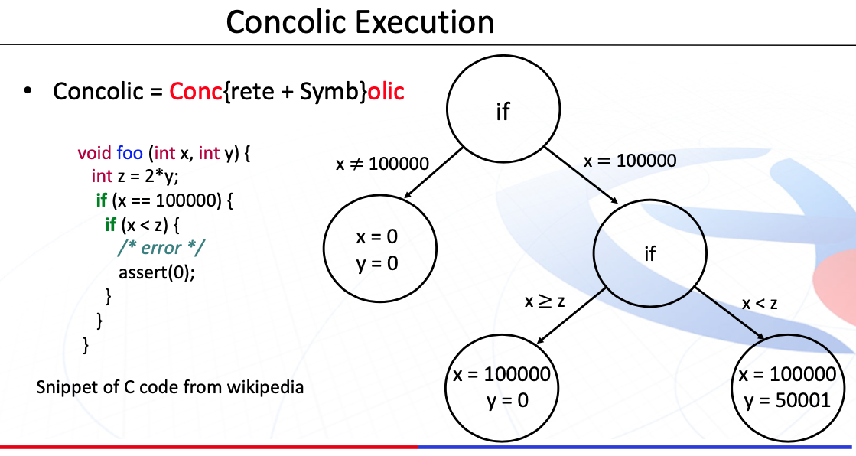
How good is KLEE (Dr. Peng Li’s slides)

Slide 52
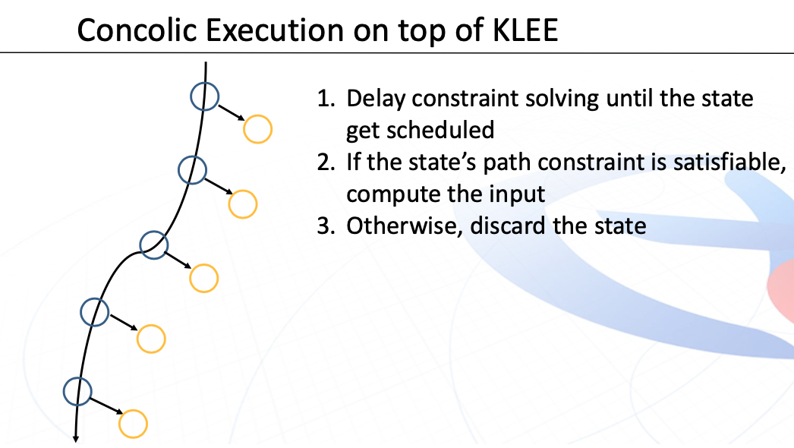
How good is KLEE (Dr. Peng Li’s slides)

Slide 53
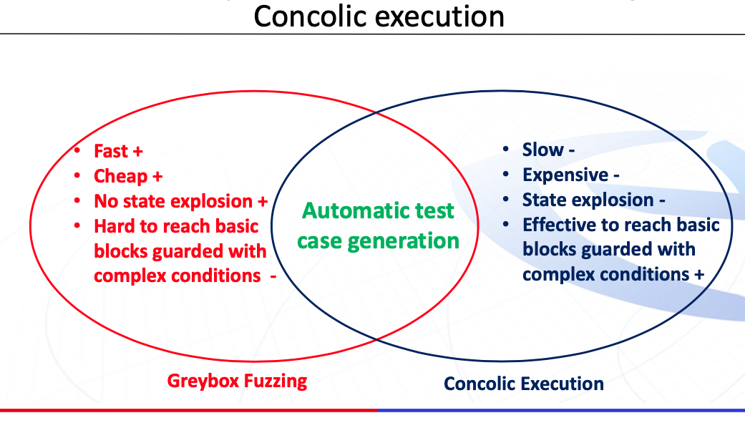
How good is KLEE (Dr. Peng Li’s slides)

Slide 54
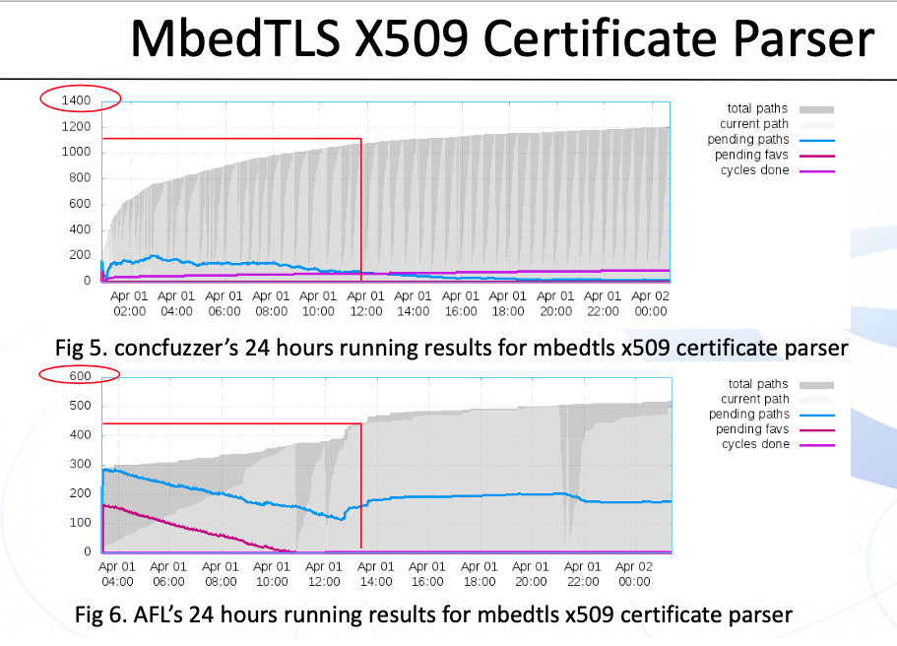
How good is KLEE (Dr. Peng Li’s slides)

Slide 55
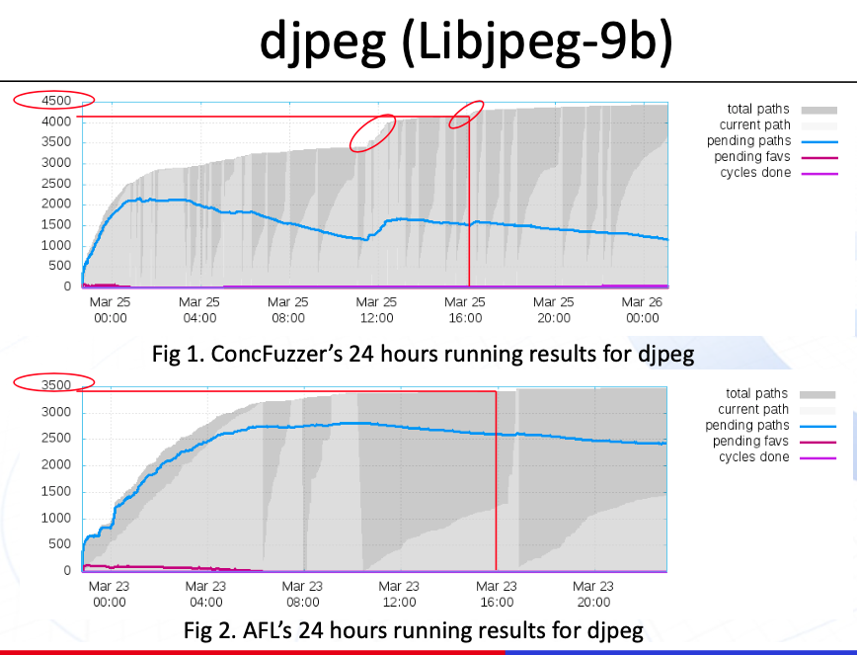
How good is KLEE (Dr. Peng Li’s slides)

Slide 56
Dr. Guodong Li’s and Dr. Peng Li’s FANTASTIC work on GKLEE follows See also Guodong’s work on PUG on the FSE 2010 publication site! It was followed by GPUVerify, another fantastic verifier from Alastair Donaldson’s groups at Imperial College, London

Slide 57
Summary
This is a huge field now – symbolic execution
You get to study this in projects
Even the MSR python Dyn Symb Executor – good project!

Slide 58
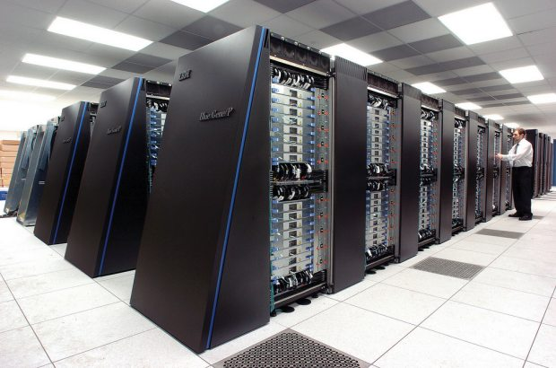
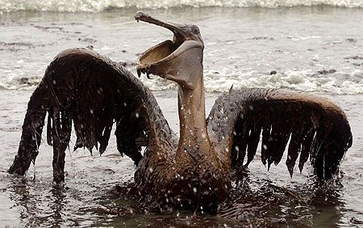
Correctness is central to Energy-Efficient Computing
The more performance per watt
we can obtain (e.g. TeraFlop in 30W,
Exaflop in 25 MW) … that is $25 Million
In electricity costs alone !!
… the less we need to depend on
dirty fuels,
… the faster we can innovate in
science and engineering
Intrepid supercomputer (Image courtesy of Argonne)
pogoprinciple.wordpress.com

Slide 59
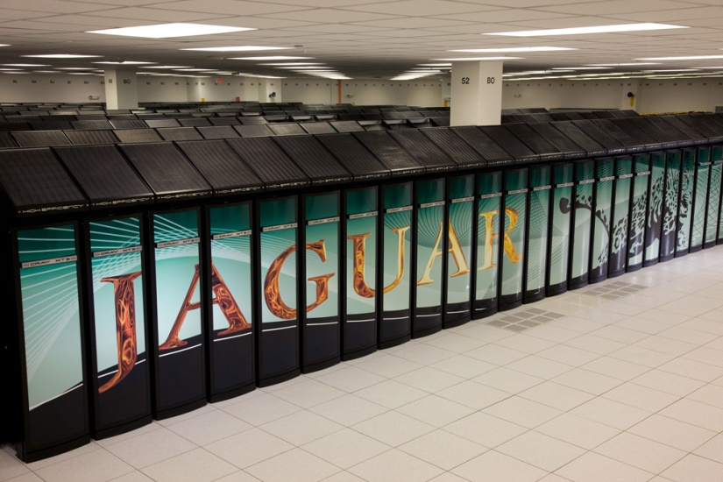
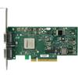
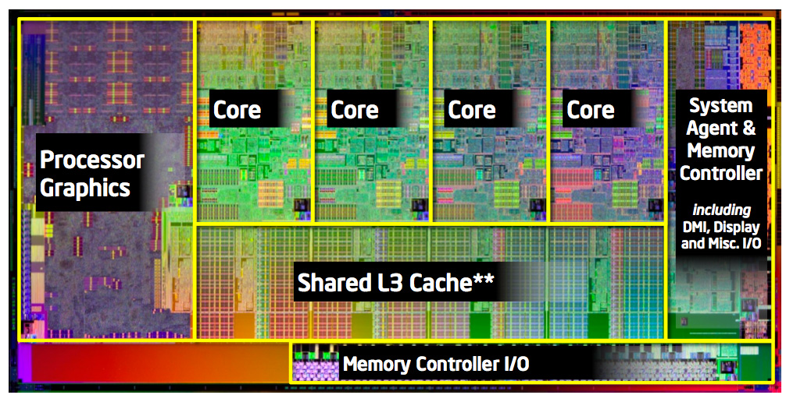
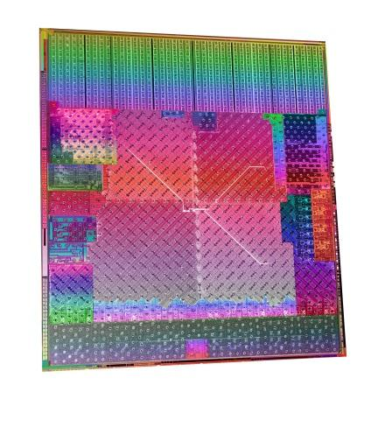
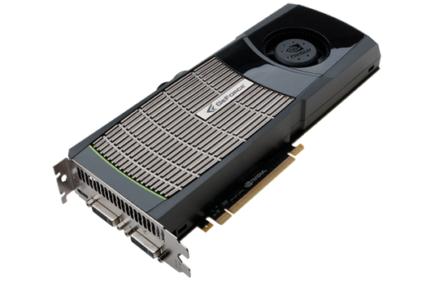
Emerging Heterogeneous Parallel Systems, and Role of Formal Methods in them
Problem Solving Environment based
User Applications
(1) Formal
Methods at the User Application Level
Problem-Solving
Environments
e.g. Uintah, Charm++, ADLB
High Performance
MPI Libraries
(2) Formal
Dynamic Methods for MPI
Concurrent
Data Structures
Infiniband style interconnect
(3) Formal
Analysis for CUDA Programs
Sandybridge (courtesy anandtech.com)
AMD Fusion APU
Geoforce GTX 480 (Nvidia)

Slide 60
Why conventional testing is inadequate
Exponential number of paths;
the bug may be deeply hidden
Exponential number of schedules; the bug may be triggered only by
one particular interleaving
Must be lucky
to schedule
threads in
this manner!
E1
…
E2
…
…
Must be lucky
to force such
“bad paths”!
En
Some bad interaction, such as
a data race may depend on
the schedule…
…

Slide 61
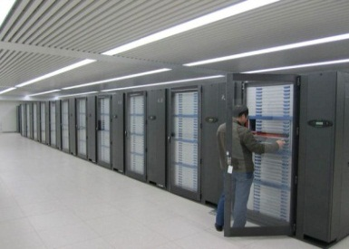
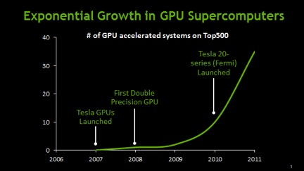


GPU-based Computing
About 40 of the top 500 machines were (in 2012) GPU-based
Personal supercomputers used for scientific research (biology, physics, …) increasingly based on GPUs
(courtesy of Nvidia,
www.engadget.com)
(courtesy of AMD)
(courtesy of Nvidia)
61

Slide 62
GKLEE (see PPoPP 2012)
__input__ int *values = (int *)malloc(sizeof(int) * NUM);
klee_make_symbolic(values, sizeof(int)*NUM, "values");
int *dvalues;
cudaMalloc((void **)&dvalues, sizeof(int) * NUM);
cudaMemcpy(dvalues, values, sizeof(int) * NUM, cudaMemcpyHostToDevice);
BitonicKernel <<< … >>> (dvalues);
Deadlocks
Data races
Concrete test inputs
Bank conflicts
Warp divergences
Non-coalesced
Test Cases
Provide high coverage
Can be run on HW
C++ CUDA Programs with Symbolic Variable Declarations
Error
Monitors
LLVM-GCC
LLVM byte-code instructions
Symbolic
Analyzer and
Scheduler

Slide 63
Our Formal Verification of CUDA builds on top of Sequential Program Verification by KLEE [OSDI ‘08]
#include "stdio.h"
#include "cutil.h"
#include "string.h"
#include "klee.h"
#define STRLEN 5
int main(){
char item;
char str[STRLEN];
int lo=0;
int hi;
int mid, found=0;
// printf("Please give char to be searched: \n");
// scanf("%c", &item);
klee_make_symbolic(&item, sizeof(item), "item");
// printf("Please give string within which to search: \n");
// scanf("%s", str);
klee_make_symbolic(str, sizeof(str), "str");
klee_assume(str[0] <= str[1]);
klee_assume(str[1] <= str[2]);
klee_assume(str[2] <= str[3]);
klee_assume(str[3] <= str[4]);
str[4] = '\0';
hi= 4; //strlen(str)-1; // strlen ignores null at the end of string
// hi points to last char in a 0 based array
while(!found && lo <= hi) {
mid = (lo+hi)/2;
if (item == str[mid])
{ printf("*");
found = 1; }
else
if (item < str[mid])
{ hi = mid-1;
printf("L"); }
else
{ lo = mid+1;
printf("H"); }
}
if (found) printf("found\n");//printf("\nitem %c found at posn %d\n", item, mid);
else printf("not found\n");//printf("\nitem %c not in str %s\n", item, str);
return found;
}
A simple Binary Search being prepared for formal symbolic analysis
This will force path coverage !!

Slide 64
Concurrency errors

Slide 65
Example: Increment Array Elements
Increment N-element array A by scalar b
tid 0 1 …
A
A[0]+b
A[1]+b
...
t0
t1
__global__ void inc_gpu(int*A, int b, intN) {
int idx = blockIdx.x * blockDim.x + threadIdx.x;
if (idx < 64) {
A[idx] = A[idx] + b;
}
65

Slide 66
Data Races in GPU Programs
The usual definition of a race:
“Two accesses, one of which is a write, that occur without
a happens-before edge between them.”
In GPUs, the happens-before is provided by
Barriers ( _syncthreads() )
Atomics
Write(a)
Write(a)
Write(a)
Read(a)

Slide 67
Illustration of Race
Increment N-element vector A by scalar b
tid 0 1 63
A
...
t0:
read A[63]
__global__ void inc_gpu(int*A, int b, int N) {
int idx = blockIdx.x * blockDim.x + threadIdx.x;
if (idx < 64) {
A[idx] = A[(idx – 1 + 64) % 64] + b;
}
t63:
write A[63]
RACE!
t63
t0
67

Slide 68
Porting Race: A Race-type Identified by us
Some hardware platforms may evaluate “then” before “else” – others may reverse this order
If we have a divergent warp where
a variable is READ in one path
and WRITTEN in another path,
then depending on the execution
order, the READ may be before/after
the WRITE

Slide 69
Example of Porting Race
#include <stdio.h>
#define NUM 32
__shared__ int v[NUM];
__global__ void PortingRace() {
if (threadIdx.x % 2) {
v[threadIdx.x] = v[ (NUM + threadIdx.x - 1) % NUM ] + 1; // W:even; R:odd
}
else {
v[threadIdx.x] = v[ (NUM + threadIdx.x + 1) % NUM ] - 1; // W:odd; R:even
}
}
int main() {
PortingRace<<<1,NUM>>>();
return 0;
}

Slide 70
CUDA-based GPU Programming Basics
A simple dialect of C++ with CUDA directives
Synchronization within Block through Barriers
(__syncthread())
Threads within block scheduled in warps
Don’t rely on warps for correctness!
Device Global Memory (shared between blocks) - Slowest
Block (Shared Memory) - Faster
Block (Shared Memory) - Faster
T0 (private Memory) - Fastest
T1 (private Memory) - Fastest
T2 (private Memory) - Fastest
T3 (private Memory) - Fastest
T0 (private Memory) - Fastest
T1 (private Memory) - Fastest
T2 (private Memory) - Fastest
T3 (private Memory) - Fastest
70

Slide 71
Conventional GPU Debuggers are Inadequate
Based on platform testing
Full generality of executions not reflected
Hard to cause races (input selection)
Hard to observe races
vector-clock based solutions that run on GPUs exist
(last time we checked) only for shared memory races

Slide 72
Some of the GPU Program Bugs
Data races
Cause unpredictable outputs
Cause compilers to misbehave
Incorrectly used synchronizations
Syncthreads not used with textual barriers
Syncthreads causing deadlocks
Misunderstood memory consistency models
When updates are visible across threads
Incorrectly used atomics (synchronization)
Due to incorrect synchronization, invariants get broken
Erroneous computational results – esp. with floating-point
Due to unpredictable computational order, results may diverge

Slide 73
Why are Data Races Highly Problematic?
Testing is seldom conclusive
Must infer a race indirectly (e.g. corrupted results)
Races manifest when code is ported or optimized
Scheduling can change
Data races make compiled results suspect
Compilers optimize assuming the absence of races in the most general setting

Slide 74
Synchronization Primitives in CUDA
Device Global Memory (shared between blocks) - Slowest
Block (Shared Memory) - Faster
Block (Shared Memory) - Faster
T0 (private Memory) - Fastest
T1 (private Memory) - Fastest
T2 (private Memory) - Fastest
T3 (private Memory) - Fastest
T0 (private Memory) - Fastest
T1 (private Memory) - Fastest
T2 (private Memory) - Fastest
T3 (private Memory) - Fastest
__kernel__ void deadlock() {
if (threadIdx.x > 0) {
v[threadIdx.x]++;
}
else {
v[threadIdx.x]--;
}
__syncthreads(); // Barrier
}
74

Slide 75
Synchronization Primitives in CUDA
Device Global Memory (shared between blocks) - Slowest
Block (Shared Memory) - Faster
Block (Shared Memory) - Faster
T0 (private Memory) - Fastest
T1 (private Memory) - Fastest
T2 (private Memory) - Fastest
T3 (private Memory) - Fastest
T0 (private Memory) - Fastest
T1 (private Memory) - Fastest
T2 (private Memory) - Fastest
T3 (private Memory) - Fastest
__kernel__ void deadlock() {
if (threadIdx.x > 0) {
v[threadIdx.x]++;
}
else {
v[threadIdx.x]--;
}
__syncthreads(); // Barrier
}
Threads within a block can
synchronize using __syncthreads().
(This call synchronizes threads, also gives
the effect of the stronger fence “thread_fence”.)
75

Slide 76
Synchronization Primitives in CUDA
Device Global Memory (shared between blocks) - Slowest
Block (Shared Memory) - Faster
Block (Shared Memory) - Faster
T0 (private Memory) - Fastest
T1 (private Memory) - Fastest
T2 (private Memory) - Fastest
T3 (private Memory) - Fastest
T0 (private Memory) - Fastest
T1 (private Memory) - Fastest
T2 (private Memory) - Fastest
T3 (private Memory) - Fastest
__kernel__ void deadlock() {
if (threadIdx.x > 0) {
v[threadIdx.x]++;
}
else {
v[threadIdx.x]--;
}
__syncthreads(); // Barrier
}
For synchronization
across blocks, we must
use one of the CUDA
Atomics (Zvonimir will
present our NFM’13 work)
Threads within a block can
synchronize using __syncthreads().
(This call synchronizes threads, also gives
the effect of the stronger fence “thread_fence”.)
76

Slide 77
Deadlocks caused by misused __syncthreads()
Cause a “hang” or unspecified behavior
__SyncThreads()

Slide 78
Illustration of “Deadlock” (conceptual deadlock; behavior is really undefined)
__global__ void kernelName (args) {
int idx = blockIdx.x * blockDim.x + threadIdx.x;
if (idx == 3) {
….
__syncthreads();
}
idx < N
idx ≥ N
__kernel__ void deadlock() {
if (threadIdx.x > 0) {
v[threadIdx.x]++;
__syncthreads();
}
else {
v[threadIdx.x]--;
__syncthreads();
}
}
Suffers from Textually
Non-aligned Barriers
(example Deadlock1.C)
78

Slide 79
Warp Divergence
__global__ void kernelName (args) {
int idx = blockIdx.x * blockDim.x + threadIdx.x;
if ( odd(idx) ) {
<Statements1>
} else {
<Statements2>
}
This is a performance bug – but can be
detected through formal symbolic analysis

Slide 80

Memory-bank Conflicts
Happen when two threads generate addresses that fall into the same memory bank
Memory Banks
This is a performance bug – but can be
detected through formal symbolic analysis

Slide 81
Non-coalesced Memory Fetches
Happen when threads generate global memory addresses that do not fully utilize the bus
Memory
This is a performance bug – but can be
detected through formal symbolic analysis
(10 x more severe than bank conflicts)

Slide 82
Two approaches to modeling
Through interleaving
Followed in most works
Through lock-step synchronous execution
Pioneered in GPUVerify

Slide 83

How bad is the interleaving problem?
It is like shuffling decks of cards
> 6 * 10^14 interleavings for 5 threads with 5 instructions
83

Slide 84
Avoiding Interleaving Explosion

Slide 85
Solution to the interleaving problem: Find representative interleavings
For Example:
If the green dots are
local thread actions,
then
all schedules
that arrive
at the “cut line”
are equivalent!

Slide 86
Solution to the interleaving problem: Find representative interleavings
For Example:
If the green dots are
local thread actions,
then
all schedules
that arrive
at the “cut line”
are equivalent!

Slide 87
Solution to the interleaving problem: Find representative interleavings
For Example:
If the green dots are
local thread actions,
then
all schedules
that arrive
at the “cut line”
are equivalent!

Slide 88
GKLEE Avoids Examining Exp. Schedules !!
Instead of considering all
Schedules and
All Potential Races…
88

Slide 89
GKLEE Avoids Examining Exp. Schedules !!
Consider JUST THIS SINGLE
CANONICAL SCHEDULE !!
Folk Theorem (proved in our paper):
“We will find A RACE
If there is ANY race” !!
Instead of considering all
Schedules and
All Potential Races…
89

Slide 90
Why does a sequential run suffice?
If the red pair is the only
race, then it occurs after
the cut-line
So all the ways to reach
the cut-line are
EQUIVALENT !!
90

Slide 91
So this sequential run is equivalent too.
You my complain saying:
“But, the sequential run
Inches Past the Cutline !!”
But hey, you told me that
this is the ONLY race!
If there were some other
race encountered before,
then that will be caught.
… there is a “first race”
and that will be caught !
91

Slide 92
Concolic execution helps find witnesses to data races
__global__ void histogram64Kernel(unsigned *d_Result, unsigned *d_Data, int dataN) {
const int threadPos = ((threadIdx.x & (~63)) >> 0)
| ((threadIdx.x & 15) << 2)
| ((threadIdx.x & 48) >> 4);
...
__syncthreads();
for (int pos = IMUL(blockIdx.x, blockDim.x) + threadIdx.x; pos < dataN;
pos += IMUL(blockDim.x, gridDim.x)) {
unsigned data4 = d_Data[pos];
...
addData64(s_Hist, threadPos, (data4 >> 26) & 0x3FU); }
__syncthreads(); ...
}
inline void addData64(unsigned char *s_Hist, int threadPos, unsigned int data)
{ s_Hist[ threadPos + IMUL(data, THREAD_N) ]++; }
“GKLEE: Is there a Race ?”
92

Slide 93
Concolic execution helps find witnesses to data races
__global__ void histogram64Kernel(unsigned *d_Result, unsigned *d_Data, int dataN) {
const int threadPos = ((threadIdx.x & (~63)) >> 0)
| ((threadIdx.x & 15) << 2)
| ((threadIdx.x & 48) >> 4);
...
__syncthreads();
for (int pos = IMUL(blockIdx.x, blockDim.x) + threadIdx.x; pos < dataN;
pos += IMUL(blockDim.x, gridDim.x)) {
unsigned data4 = d_Data[pos];
...
addData64(s_Hist, threadPos, (data4 >> 26) & 0x3FU); }
__syncthreads(); ...
}
inline void addData64(unsigned char *s_Hist, int threadPos, unsigned int data)
{ s_Hist[ threadPos + IMUL(data, THREAD_N) ]++; }
Threads 5 and and 13 have a WW race
when d_Data[5] = 0x04040404 and d_Data[13] = 0.
GKLEE
93

Slide 94
Summary
This is a huge field now – symbolic execution
You get to study this in projects
Even the MSR python Dyn Symb Executor – good project!

